Slide 1
Discovering the disease

Slide 2
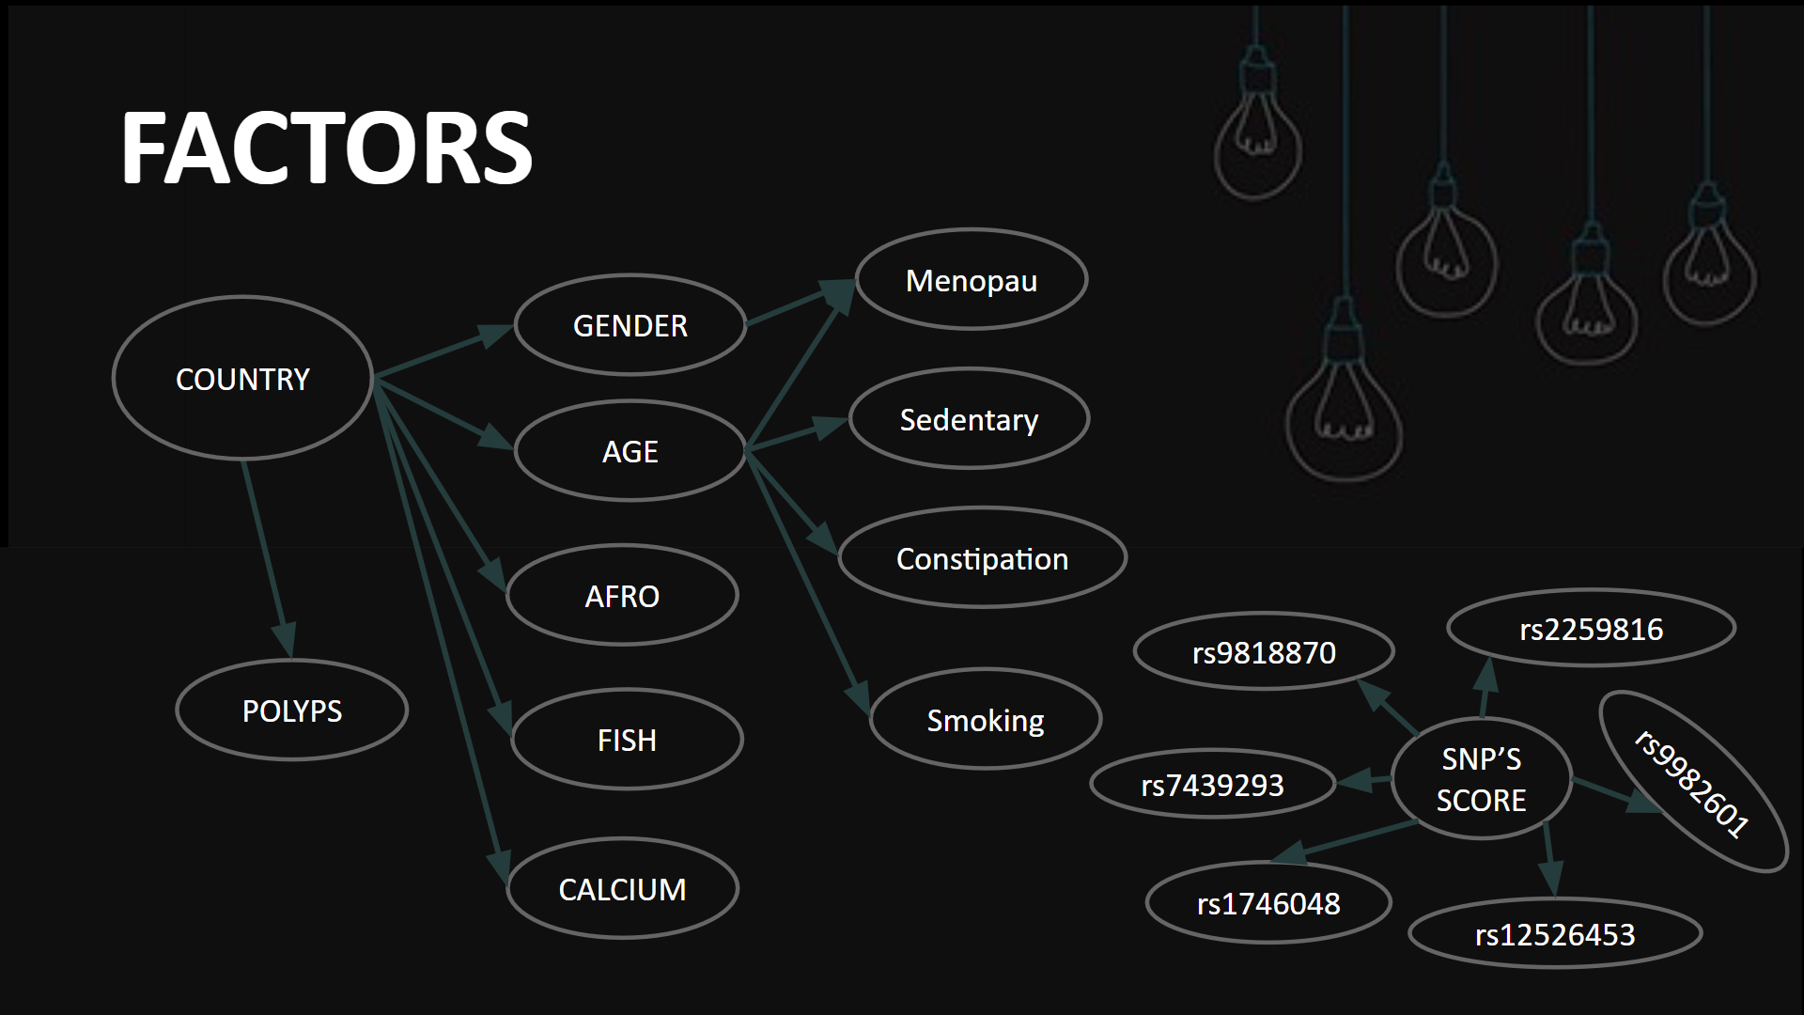
ENVIRONMENTAL AND CLINICAL RISK FACTORS

Slide 3
ODDS RATIO FOR FACTORS
FACTOR | ODDS RATIO | FACTOR | ODDS RATIO
Women | 0.913 | Fish Consumption | 0.89
Man | 1.095 | Diabetes | 0.35
Man Afro Age Classified | 1.17 / 1.16 / 1.38 50-54 / 55-59 / 60-64 | Red meat intake Week consumption freq | 1 / 3.76 / 9.35 0-1 / 2-3 / 4 or more
Woman Afro Age Classified | 1.23 / 1.51 / 1.35 50-54 / 55-59 / 60-64 | Calcium intake mg/day | 1 / 0.98 / 0.88 0-570 / 570-1170 / >1170
Bowel polyps | 2.8 | Smoking | 1.5
Age >50 years old | 2.6 | Diagnosis in first relatives | 4.9
Coffee consumption Coffee cups/day | 1 / 0.88 / 0.9 / 0.78 0 / 1 / 2 / 3 or more | Constipation history | 1 / 0.79 / 1.33 / 5.6 Never / rarely / once a month / every week
Oral anticonceptives | 0.89 | Long Term Sedentary Work | 1.94
Menopause | 0.67 | Inflammatory Bowel Disease | 2.5
Fruits-vegetables consumption | 1 / 1.72 / 2.08 Daily / often /rarely | Genetic Score Based on 13 SNPs | 1 / 1.63 / 2.87 <11 / 12-16 / >=17
Obesity | 4.3

Slide 4
THE DISEASE
COLORECTAL CANCER

